Slide 1
Enterprise PSA on SAP BTP
TEAM:
  RISHABH
  SAMYUKTHA
  SAVISHNA
  SRINIDHI
  MOHAN
  KEVIN
  VIGNESH
  SRINANDHAN
  AJAY
Functional Requirements Deck
SAP BTP CAP + Fiori | Version 1 | 10 Oct 2026
Team 1 - Business Analysis
Notes:
Introduce the PSA initiative: one SAP BTP application for time, budget and billing.

Slide 2
Business problem
Problem | Business impact | Addressed by
Scope creep: a task burns hours unseen until the whole project budget is breached | Margin erosion, unplanned write-offs, strained client relationships | FR-003, FR-008, FR-009
Disconnected systems: hours in third-party trackers, finance reconciles spreadsheets | Slow, error-prone invoicing; revenue leakage; delayed cash collection | FR-005, FR-010, FR-011
No real-time tracking: budget consumption visible only at month end | Late corrective action; surprise overruns | FR-004, FR-007
.
Notes:
Three problems, each traced to the requirements that fix it.

Slide 3
Objectives and scope
Objectives
In scope
Out of scope
Track time per Task; roll up to Project and Budget
Alert managers at consumption thresholds
Invoice from approved hours, no spreadsheets
Support Fixed, T&M and Retainer billing
One role-based source of truth
CAP Node.js services, OData v4, HANA Cloud
Fiori Elements app (ALP, List Report, Object Page)
Roll-up, alerts, approvals, invoicing
XSUAA, audit log, Destination service
5 integrations (HR, finance, tracker, DIM, alerts)
Native mobile app
Payroll and compensation
Full accounting, tax, general ledger
Capacity planning (Phase 2)
Client portal (Phase 2); multi-tenant SaaS
60%
less invoice prep effort
50%
faster invoice cycle
<1 min
timesheet to dashboard
95%
timesheets on time
Notes:
Objectives, what is in scope and what is deferred to Phase 2, with headline targets.

Slide 4
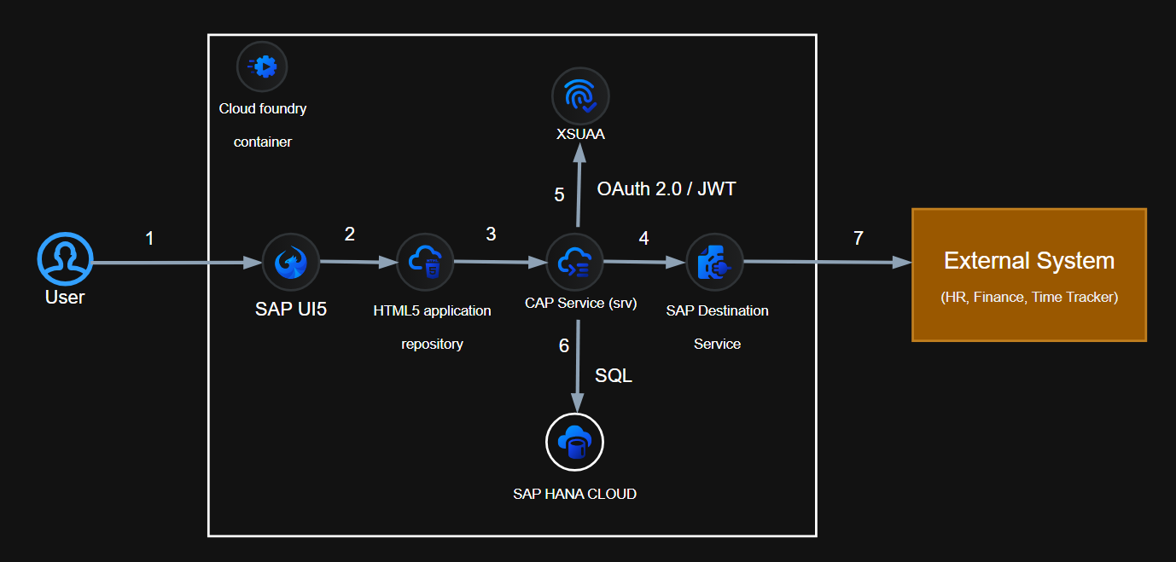
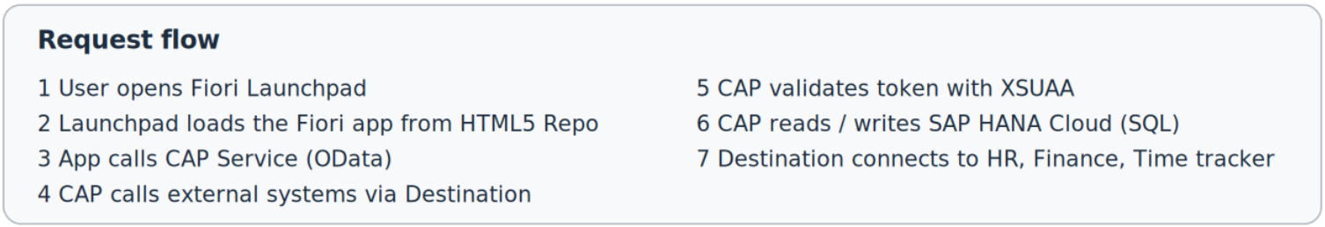
Solution architecture
Presentation
Notes:
Three-tier CAP pattern on Cloud Foundry: Fiori in HTML5 Repository, CAP services behind XSUAA, HANA Cloud.

Slide 5



Business roles and actors
Role | What they do | Typical users | Access scope
Employee | Logs time, submits weekly timesheet | Consultants, engineers | Own timesheets, assigned tasks
Project Manager | Owns projects and budgets, approves time | Delivery managers | Own projects only
Finance User | Generates and tracks invoices | Finance, billing team | Approved hours and invoices
Department Head | Views utilisation and portfolio | Practice leads | Own department
Administrator | Master data, roles, thresholds | PSA admins, IT | Configuration; audit read-only
Employees cannot approve own timesheets
Finance cannot edit approved hours
Every write is audit-logged
Notes:
Five roles with row-level access. Segregation of duties is enforced and writes are audited.

Slide 6
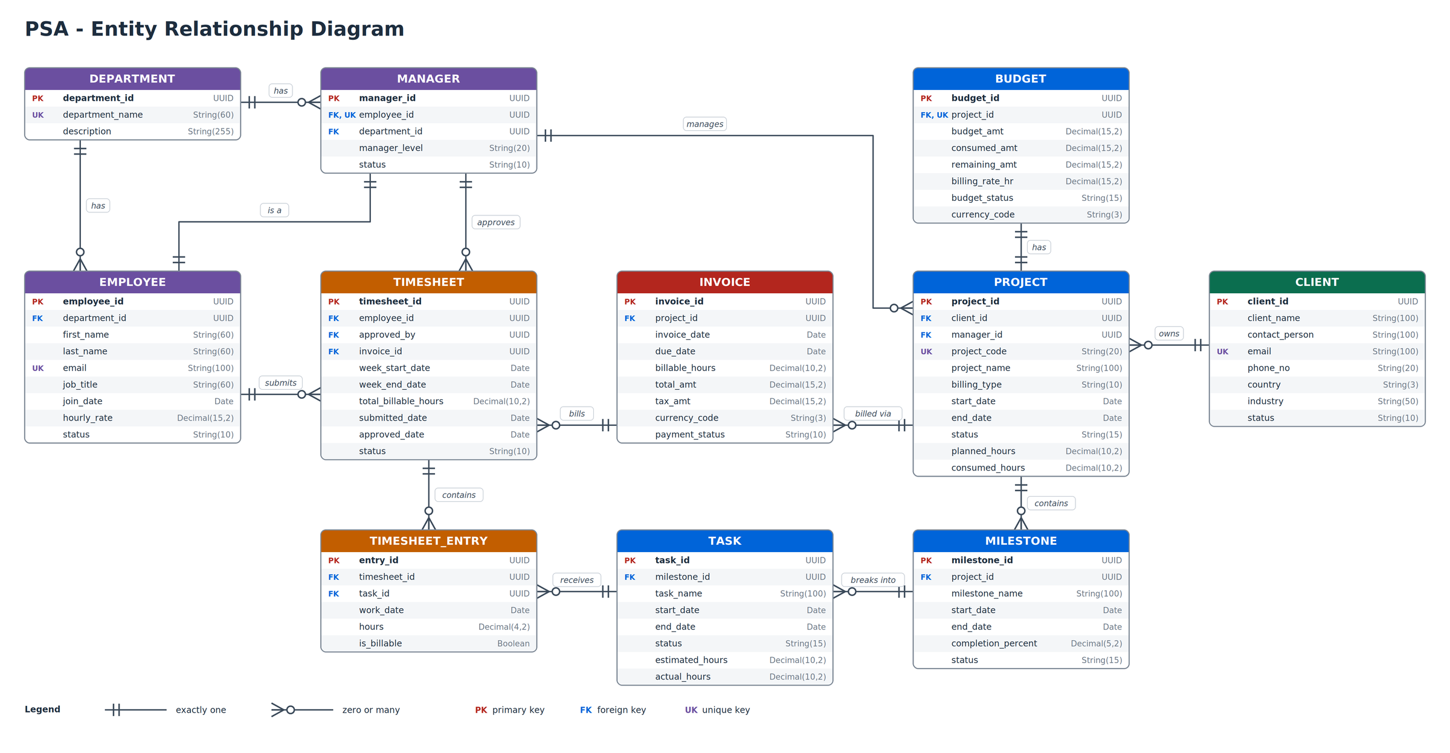
ER diagram: 11 entities
Budget is 1:1 with Project
Task is where time is booked
Entry = one day, one task
Invoice bills many Timesheets
Notes:
Eleven entities; Budget is 1:1 with Project; Entry is one day of hours on one Task.

Slide 7
Key request flows
Log time
Add task hours
>
Submit weekly
>
CAP validates
>
Roll-up updates
>
Threshold alert
Approve time
Open approvals
>
Approve or reject
>
Reason if rejected
>
Employee notified
>
Approved hours billable
Invoice
Pick project, period
>
Collect approved hours
>
Compute by billing type
>
Link timesheets
>
PDF to DIM
Monitor
Open project ALP
>
Budget burn
>
Milestone progress
>
At-risk tasks
Roll-up: Entry hours > Task actual > Project consumed > Budget amount, within 60 seconds.
Notes:
Four request flows: log, approve, invoice, monitor. Budget roll-up completes within 60 seconds.

Slide 8
Actions and functions
Name | Service | Type | Behaviour
submitTimesheet | Employee | Bound action | Validates 24 h cap, locks entries, triggers roll-up
approveTimesheet | Project | Bound action | Approves, stamps approver, notifies employee
rejectTimesheet | Project | Bound action | Rejects with mandatory reason, notifies
recalculateBudget | Project | Bound action | Recomputes consumed and remaining amounts
generateInvoice | Billing | Action | Builds invoice from approved, un-invoiced hours
issueInvoice | Billing | Bound action | Draft to Issued, PDF to DIM, notifies client
markInvoicePaid | Billing | Bound action | Sets status Paid
getBurnSummary | Project | Function | Budget, hours, burn rate, projected end
Notes:
Eight actions and functions across Employee, Project and Billing services, plus a nightly job.

Slide 9
Functional requirements
FR-001
FR-005
FR-009
Maintain master data
Import hours from time trackers
Alerts at 75, 90 and 100%
FR-002
FR-006
FR-010
Create project with one budget
Approve or reject with reason
Invoices for Fixed, T&M, Retainer
FR-003
FR-007
FR-011
Define milestones and tasks
Budget updates within 60 seconds
Invoice lifecycle, no double billing
FR-004
FR-008
FR-012
Log hours, save draft, submit weekly
Task burn: warn 80%, error 100%
Row-level access and audit log
Critical (10): must have for go-live High (2): needed in first release
Notes:
Twelve requirements: ten critical, two high.

Slide 10
Fiori UI requirements
Screen | Template | Key elements
Manager Home | Analytical List Page | KPI cards, smart table with filters, drill-down to project
Project Detail | Object Page | Header with code, client, status, budget health; facets for Budget, Milestones and Tasks, Timesheets, Invoices
My Timesheet | Object Page + actions | Weekly task-by-day grid, billable toggle, Save Draft and Submit
Timesheet Approvals | List Report + Object Page | Filter by employee, project, week; Approve and Reject with mandatory reason
Billing Workbench | ALP + Object Page | KPI cards, Generate Invoice, Issue and Mark Paid
Notes:
Five Fiori screens and the Fiori Elements template behind each.

Slide 11
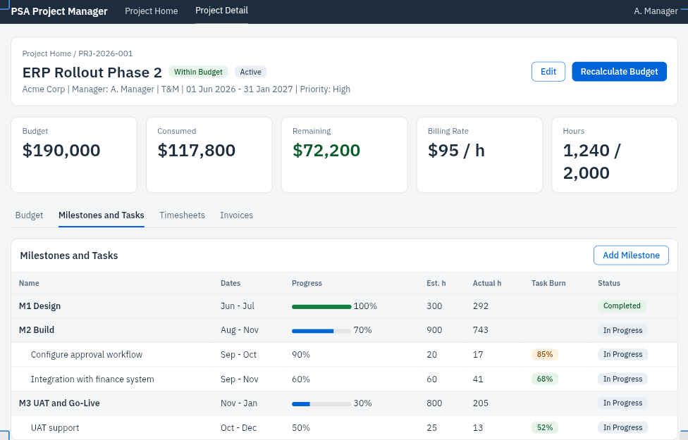
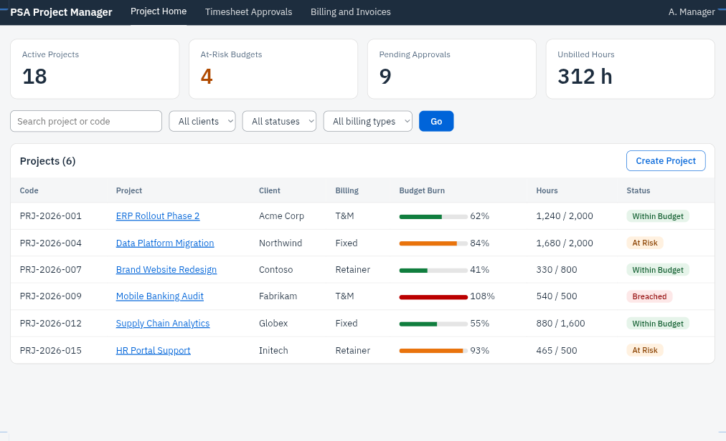
Fiori screens: manager
Manager Home (ALP): KPI cards, filters, budget burn per project
Project Detail (Object Page): budget health, milestones, task burn, Recalculate Budget
Notes:
Manager screens: Project Home and Project Detail.

Slide 12
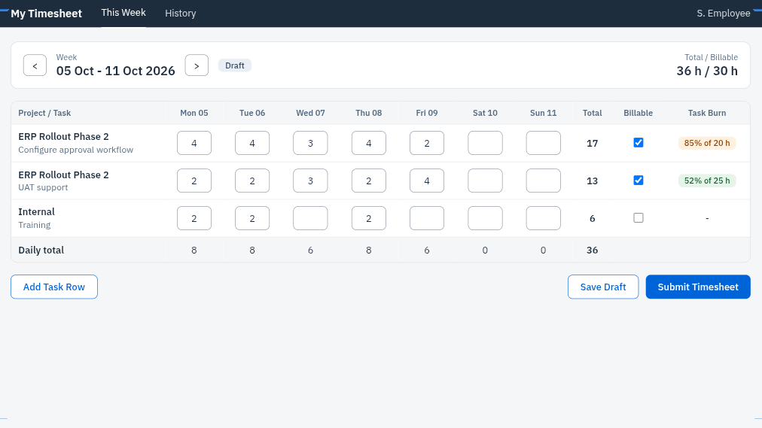
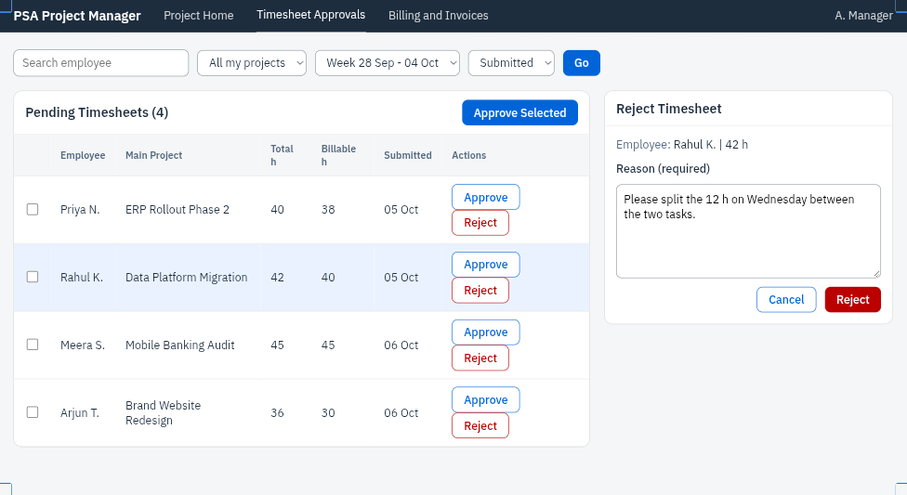
Fiori screens: timesheets
My Timesheet: weekly grid, billable toggle, task burn, Save Draft and Submit
Approvals: bulk approve; rejection requires a reason
Notes:
Timesheet screens: employee grid and manager approvals.

Slide 13
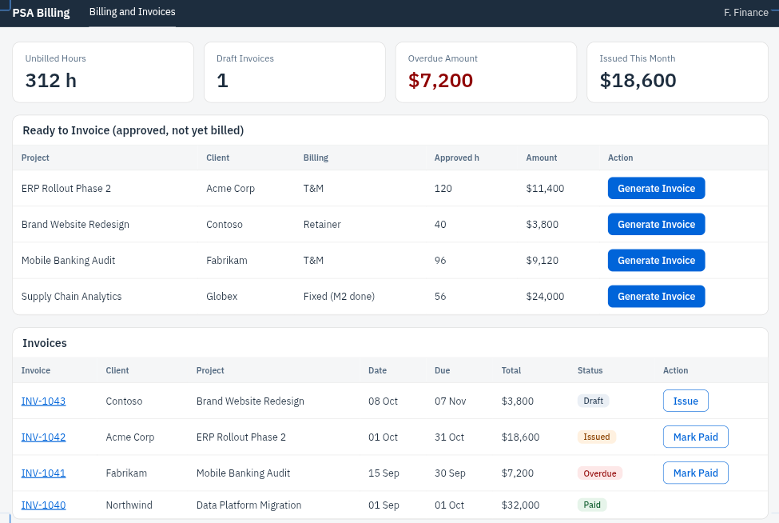
Fiori screens: billing
Billing Workbench
KPI cards: unbilled hours, draft invoices, overdue amount
Generate Invoice from approved hours
Issue and Mark Paid actions
Draft
Issued
Paid
Invoiced timesheets are locked; no hour is billed twice.
Notes:
Billing workbench and invoice lifecycle.

Slide 14
Non-functional requirements
<3 s
300
99.5%
2 M
dashboard load, p95
peak concurrent users
business-hours uptime
timesheet entries supported
Roll-up speed
Budget roll-up within 60 seconds of submission (NFR-005)
Delivery
MTA: psa-db, psa-srv, psa-app; DEV, QAS, PROD via SAP CI/CD (NFR-006)
Security
XSUAA OAuth 2.0, SAML SSO, row-level access, audit trail
Testing
Unit (Jest), integration (Postman), UI (Fiori), security (pen test)
Notes:
Performance, scale, delivery, security and testing targets.

Slide 15



Conclusion
What PSA delivers
Next steps
Live budget burn from task to project
Alerts before scope creep becomes overrun
Invoices straight from approved hours
Role-based, audited, single source of truth
Approve FRD v1
Confirm HR and finance integration targets
Start CAP + Fiori build; plan Phase 2
Thank you | Questions?
Notes:
Summarise value, ask for FRD approval, confirm integration targets, then open for questions.

